Slide 1
Graph Transformers

Slide 2
Overview
Recap
Introducing transformers
Transformers as a GNN
Transformers on graphs

Slide 3
Recap

Slide 4
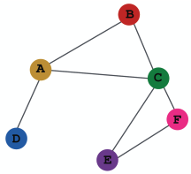
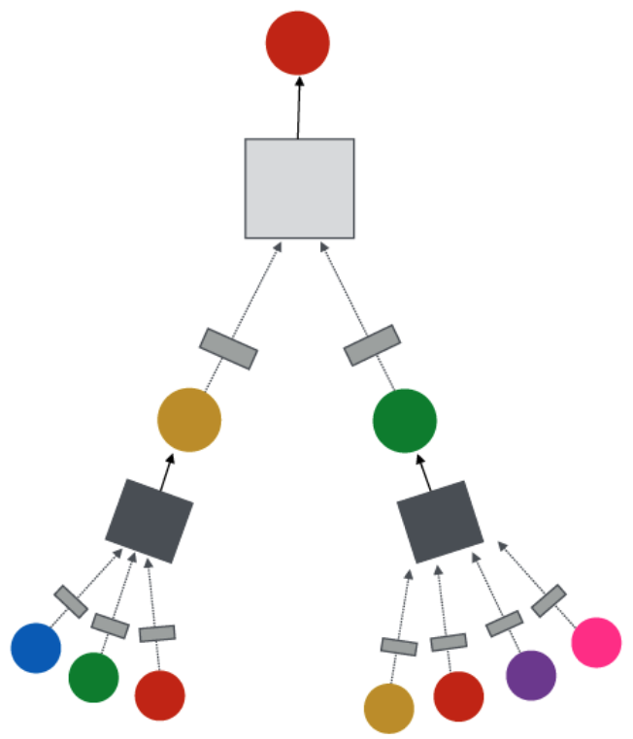
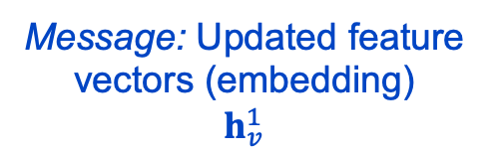
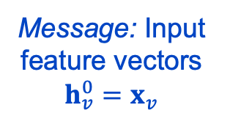
Message passing as a general GNN framework
Target node
Learning objective
GNN Layer 2
Input graph
Message: Updated feature vectors (embedding)
$$h_{v}^{1}$$
Layer Operations
Neighborhood message aggregation
Node message (embedding) update
GNN Layer 1
Message: Input feature vectors $h_{v}^{0}=x_{v}$
Graph augmentation
Image credit: Jure Leskovec, http://cs224w.stanford.edu

Slide 5
Message passing as a general GNN framework
We have covered a lot about the GNN design space
What can we say about the Graph Transformer design space?
GNN Design Space
Graph Transformer Design Space
Learning objective
GNN Layer 2
?
Layer Operations
Message aggregation
Embedding update
GNN Layer 1
Graph augmentation
Image credit: Jure Leskovec, http://cs224w.stanford.edu

Slide 6
Introducing transformers

Slide 7

Transformers are the foundation of today’s generative AI
Introduced by Vaswani et al. in 2017
Introduces the concept of self-attention
Includes encoder and decoder components
Encoder forms a representation of the input
Decoder processes that to generate output
Initial applications were NLP focused. Later applications include computer vision and time series.
All LLMs / LRMs based on transformers
Image credit: Vaswani et, 2017

Slide 8
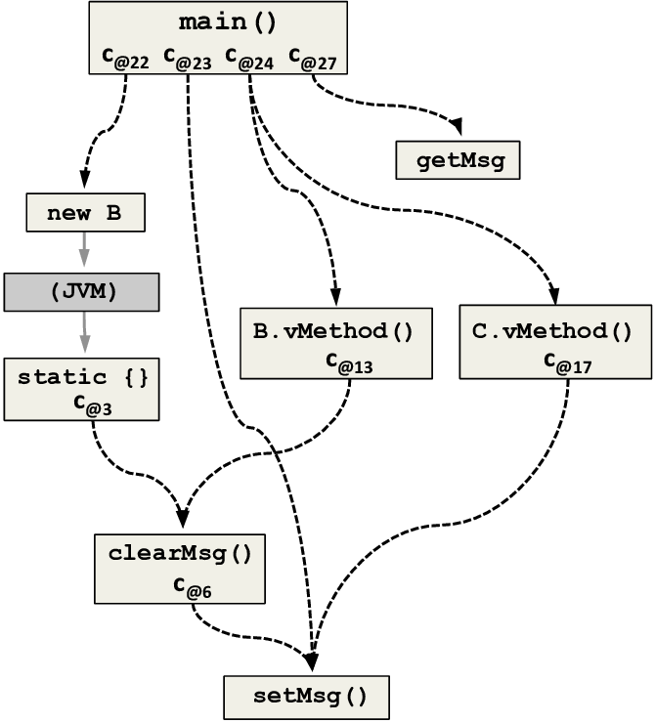
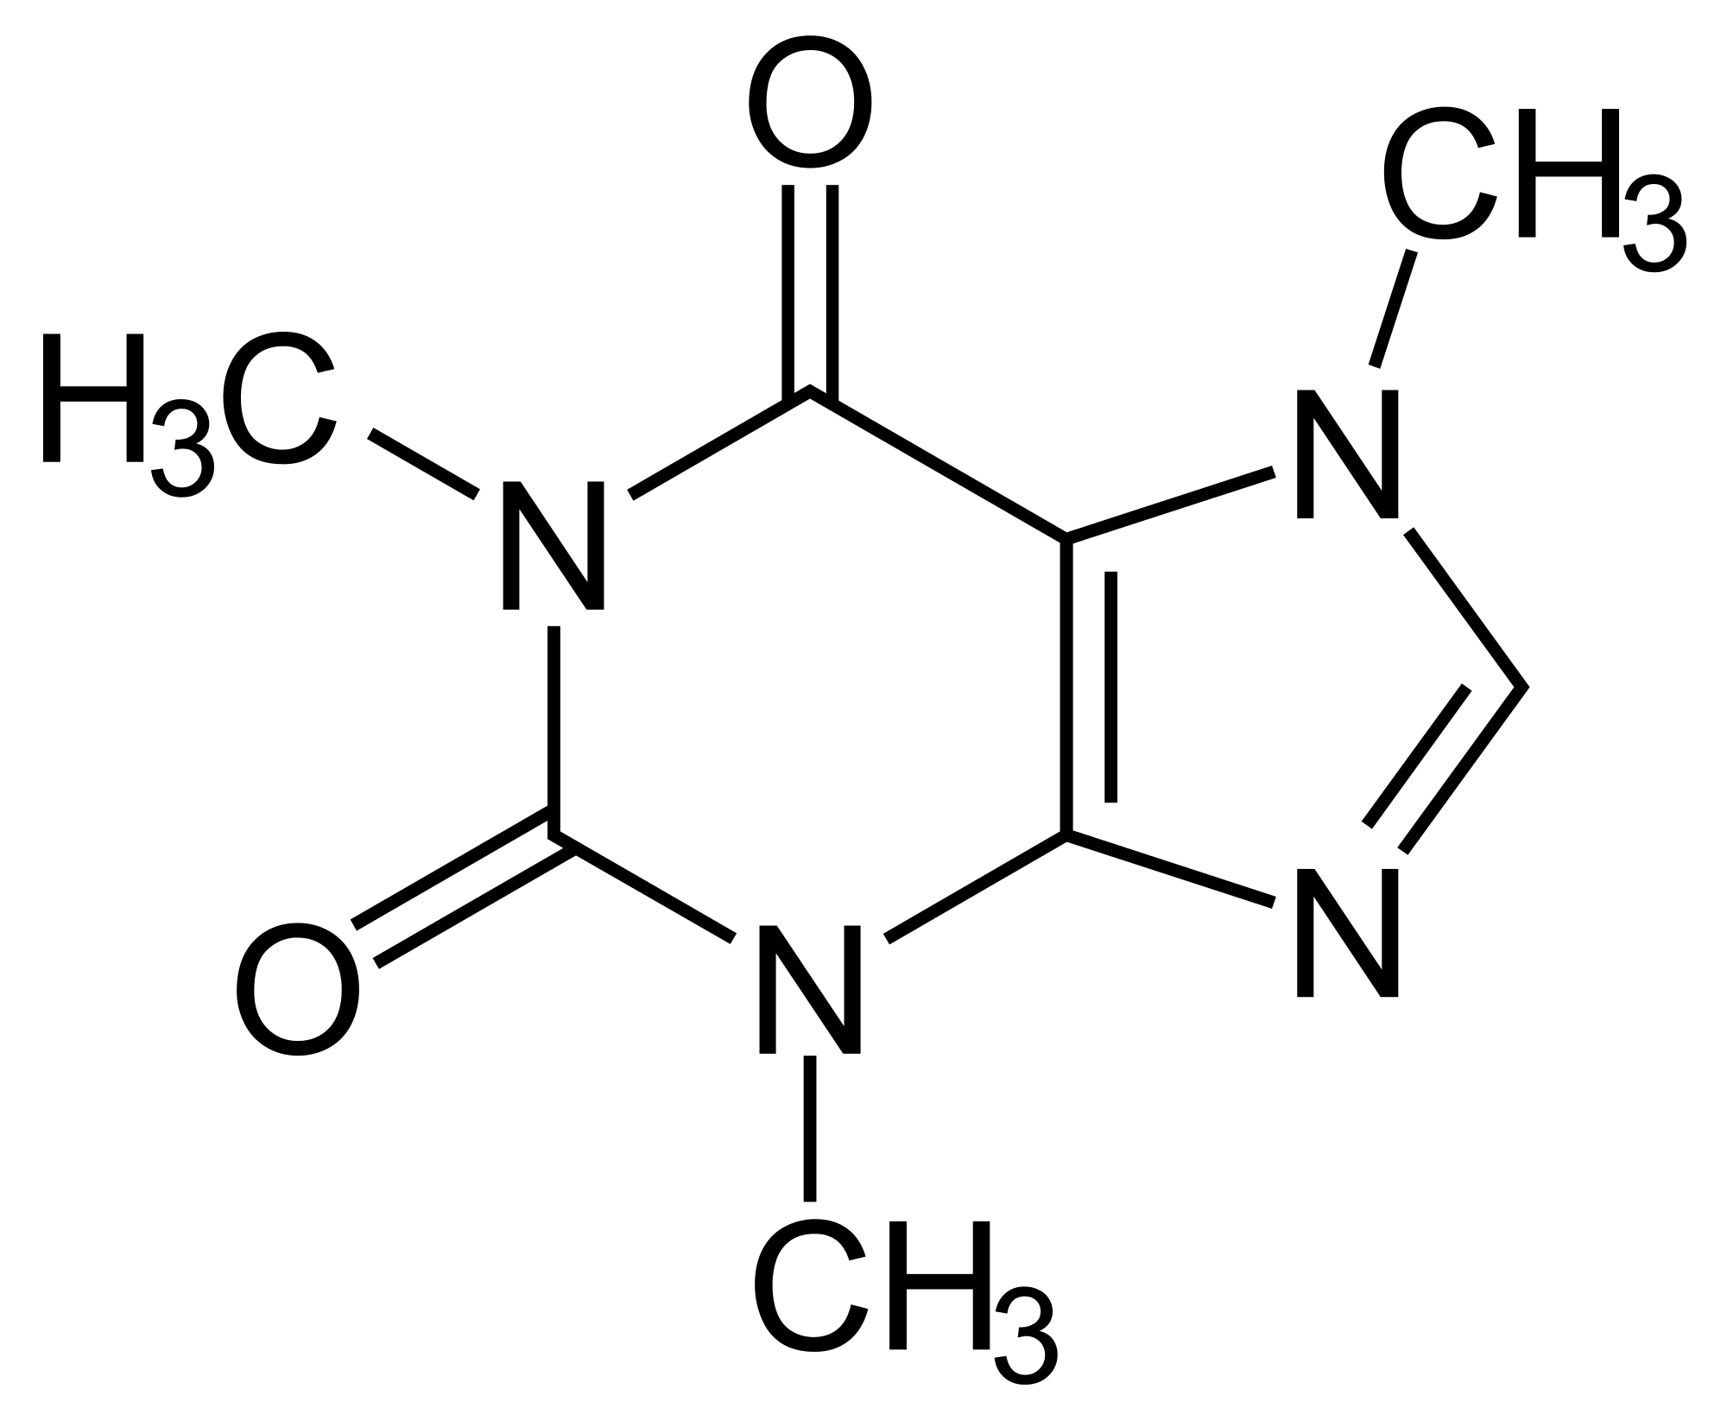
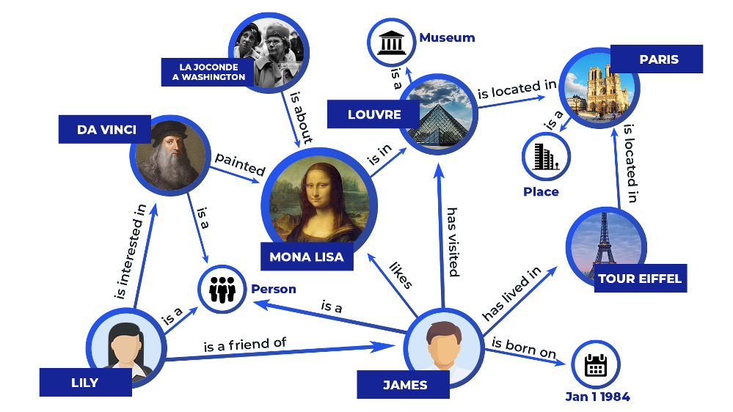
Leveraging transformers for graphs
There are many multi-billion node / graph scale data
Software execution
Molecules
Knowledge graphs
Image credit: Chemistry StackExchange
Image credit: ResearchGate
Image credit: Zilliz

Slide 9
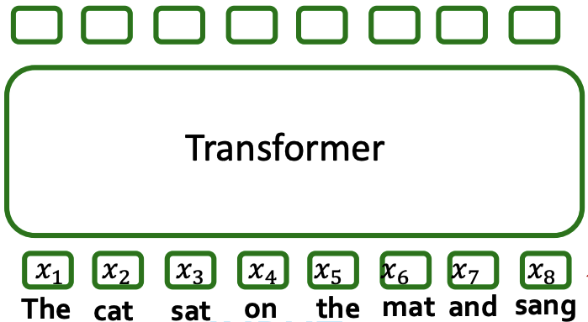
Transformers and input tokens
Transformers map sequences of vectors to sequences of vectors (encoder)
Note: There is a one-to-one correspondence between input and output vectors for tokens in the Transformer encoder. The transformer decoder is used to generate the next token.
Next token
Output
Tokens
Input
Image credit: Jure Leskovec, http://cs224w.stanford.edu

Slide 10
Transformers and input tokens
Transformers map sequences of vectors to sequences of vectors (encoder)
Each token describes a piece of the input, e.g. a word
What is the output sequence?
Option 1: next token (decoder) (this is what GPTs do)
Note: There is a one-to-one correspondence between input and output vectors for tokens in the Transformer encoder. The transformer decoder is used to generate the next token.
Next token
Output
Tokens
Input
Image credit: Jure Leskovec, http://cs224w.stanford.edu

Slide 11
Transformers and input tokens
Transformers map sequences of vectors to sequences of vectors
Each token describes a piece of the input, e.g. a word
What is the output sequence?
Option 1: next token (decoder) (this is what GPTs do)
Option 2: pool and infer something (other modules) (e.g., document class)
Pool and infer
Note: Here, the transformer encoder output is passed to other neural network models (e.g., MLP). The transformer decoder is not used.
Output
Tokens
Input
Image credit: Jure Leskovec, http://cs224w.stanford.edu

Slide 12
Transformers architecture
How are the input tokens processed?
Several components
Positional encodings (more later)
Multi-head self-attention
Normalization
Feedforward networks
What is self-attention and how does it work?
Image credit: Vaswani et, 2017

Slide 13
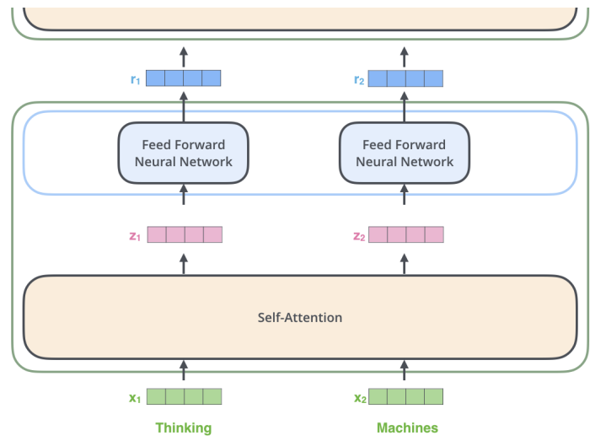
Transformer self-attention
Multi-head attention blocks each individually perform self-attention
Dynamically modify input representation to account for context
Encoder 2
Encoder 1
Encoder
Image credit: Vaswani et, 2017
Image credit: https://jalammar.github.io/illustrated-transformer/

Slide 14

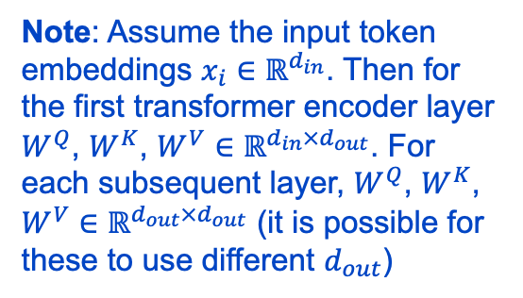
Transformer self-attention
Step 1: compute key, value, and query for each input token
Step 1
The
doctor
treated
Model parameters
Input
Query
W^{Q}
Note: Assume the input token embeddings $x_{i}∈ℝ^{d_{in}}$. Then for the first transformer encoder layer $W^{Q}$, $W^{K}$, $W^{V}∈ℝ^{d_{in}×d_{out}}$. For each subsequent layer, $W^{Q}$, $W^{K}$, $W^{V}∈ℝ^{d_{out}×d_{out}}$ (it is possible for these to use different $d_{out}$)
Key
W^{K}
Value
W^{V}
A query, key, and value vector is generated for every input vector using the matrices W^{Q}, W^{K}, and W^{V}. These matrices are learned during model training.

Slide 15
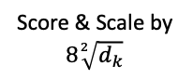
Transformer self-attention
Step 1: compute key, value, and query for each input token
Step 2: For each token, compute scores for every other token and scale
Step 1
Step 2
The
doctor
treated
Input
x₁
x₂
x₃
The
doctor
treated
Model parameters
Input
Query
q₁
q₂
q₃
Query
W^{Q}
k₃
Key
k₁
k₂
Value
v₁
v₂
v₃
Key
W^{K}
Score & Scale by $8\sqrt[2]{d_{k}}$
q₁·k₁=14
q₁·k₂=12
q₁·k₃=4
Softmax
c₁₁=0.86
c₁₂=0.12
c₁₃=0.02
Value
W^{V}
The illustrated computations are for the computation of z₁. The same process is repeated for every input x_{i}. For example, to compute z₃, it is necessary to compute dot products q₃k₁, q₃k₂, q₃k₃ to obtain new softmax scores c₃₁, c₃₂, c₃₃ and finally new scaled value vectors c₃₁v₁, c₃₂v₂ and c₃₃v₃.

Slide 16
Transformer self-attention
Step 1: compute key, value, and query for each input token
Step 2: For each token, compute scores for every other token and scale
Step 3: Update embedding as a weighted sum of token value vectors
Step 1
Step 2
The
doctor
treated
Input
x₁
x₂
x₃
The
doctor
treated
Model parameters
Input
Query
q₁
q₂
q₃
Query
W^{Q}
k₃
Key
k₁
k₂
Value
v₁
v₂
v₃
Key
W^{K}
Score & Scale by $8\sqrt[2]{d_{k}}$
q₁·k₁=14
q₁·k₂=12
q₁·k₃=4
Softmax
c₁₁=0.86
c₁₂=0.12
c₁₃=0.02
Value
W^{V}
Softmax X Value
The illustrated computations are for the computation of z₁. The same process is repeated for every input x_{i}. For example, to compute z₃, it is necessary to compute dot products q₃k₁, q₃k₂, q₃k₃ to obtain new softmax scores c₃₁, c₃₂, c₃₃ and finally new scaled value vectors c₃₁v₁, c₃₂v₂ and c₃₃v₃.
c₁₁ v₁
c₁₂ v₂
c₁₃ v₃
Sum
z₁ = c₁₃ v₁ + c₁₂ v₂ + c₁₃ v₃
Step 3

Slide 17
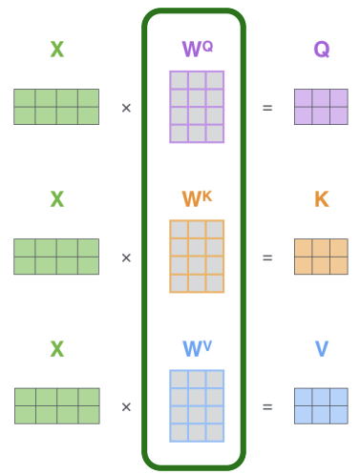
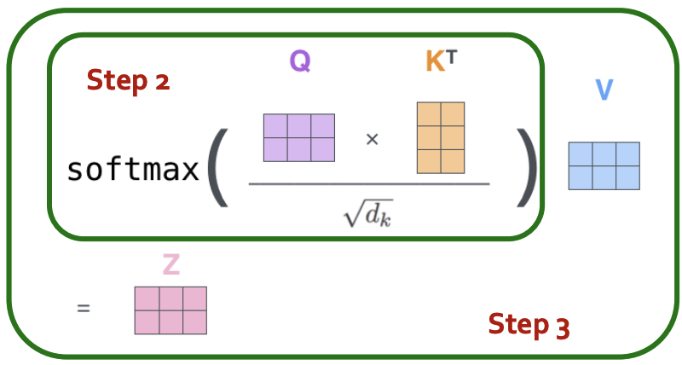
Transformer self-attention
Same calculation in matrix form
Step 1
Model parameters
Image credit: https://jalammar.github.io/illustrated-transformer/

Slide 18
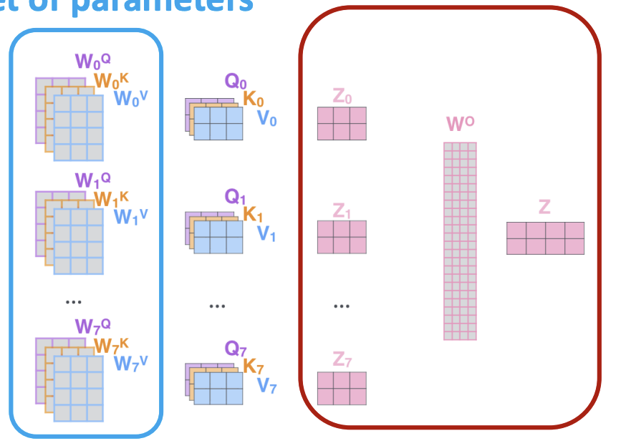
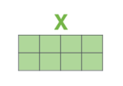
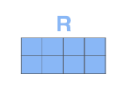
Transformer multi-head self-attention
Perform several self-attentions in parallel and combine results
Different attention heads learn different relations among inputs
Each has its own learning parameters
Word embedding inputs
The input to subsequent layers is the output of the previous layer
Image credit: https://jalammar.github.io/illustrated-transformer/

Slide 19
For more details on transformers for text, I highly recommend Jay Alammar’s The Illustrated Transformer
https://jalammar.github.io/illustrated-transformer/

Slide 20
Transformers as a GNN

Slide 21
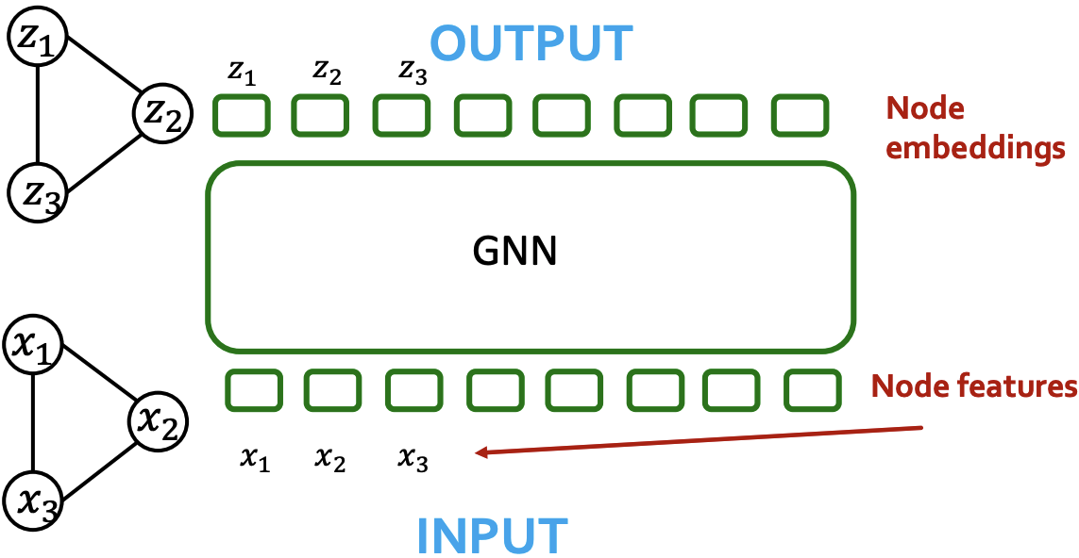
Comparing transformers and GNN
Similarities
Both take a sequence of vectors and output embeddings
Both are permutation invariant and equivariant
Differences
GNNs use message passing, Transformers use self-attention
Image credit: Jure Leskovec, http://cs224w.stanford.edu

Slide 22
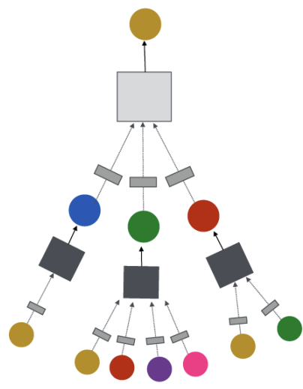
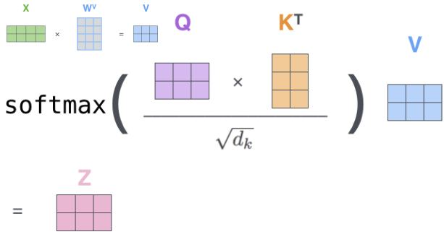
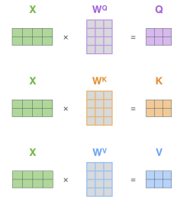
Comparing transformers and GNN
Are self-attention and message passing really different?
Message Passing
Self-attention
?
=
Image credit: Jure Leskovec, http://cs224w.stanford.edu

Slide 23
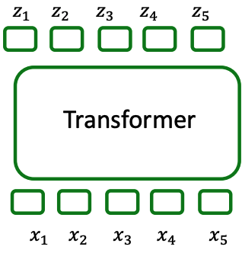
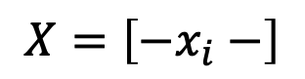
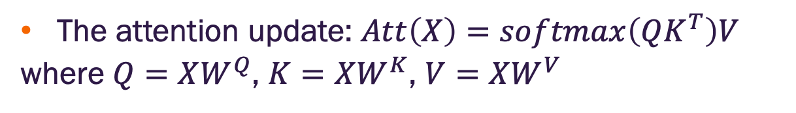
Self-attention can be cast as message passing
The attention update: $Att\left(X\right)=softmax\left(QK^{T}\right)V$
where $Q=XW^{Q}$, $K=XW^{K}$, $V=XW^{V}$
Inputs stored row-wise
$$X=\left[−x_{i}−\right]$$
Output
Input tokens
Image credit: Jure Leskovec, http://cs224w.stanford.edu

Slide 24
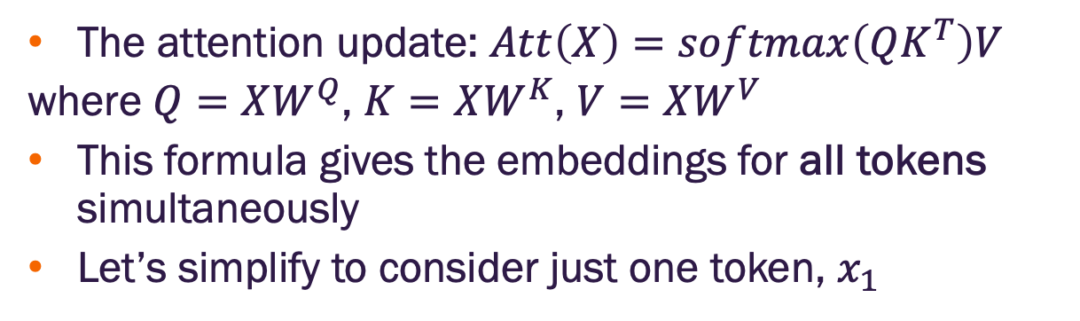
Self-attention can be cast as message passing
The attention update: $Att\left(X\right)=softmax\left(QK^{T}\right)V$
where $Q=XW^{Q}$, $K=XW^{K}$, $V=XW^{V}$
This formula gives the embeddings for all tokens simultaneously
Let’s simplify to consider just one token, $x_{1}$
Inputs stored row-wise
$$X=\left[−x_{i}−\right]$$
Output
Input tokens
Image credit: Jure Leskovec, http://cs224w.stanford.edu

Slide 25
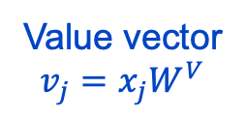
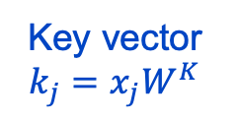
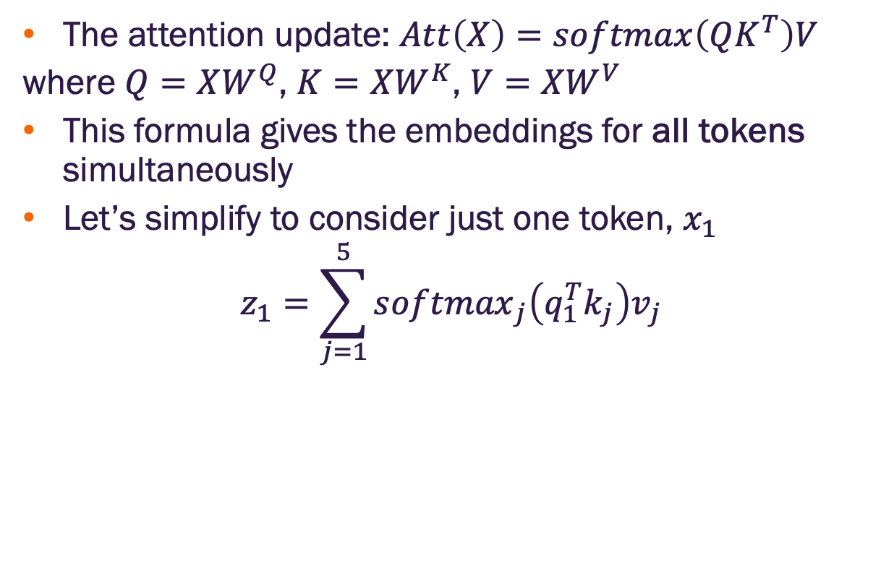

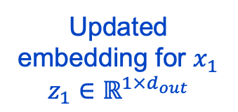
Self-attention can be cast as message passing
The attention update: $Att\left(X\right)=softmax\left(QK^{T}\right)V$
where $Q=XW^{Q}$, $K=XW^{K}$, $V=XW^{V}$
This formula gives the embeddings for all tokens simultaneously
Let’s simplify to consider just one token, $x_{1}$
$$z_{1}=\sum_{j=1}^{5}{{softmax}_{j}\left(q_{1}^{T}k_{j}\right)v_{j}}$$
Inputs stored row-wise
$$X=\left[−x_{i}−\right]$$
Output
Updated embedding for $x_{1}$
$$z_{1}∈ℝ^{1×d_{out}}$$
Query vector
$$q_{1}=x_{1}W^{Q}$$
Key vector
$$k_{j}=x_{j}W^{K}$$
Value vector
$$v_{j}=x_{j}W^{V}$$
How should we interpret this?
Input tokens
Image credit: Jure Leskovec, http://cs224w.stanford.edu

Slide 26
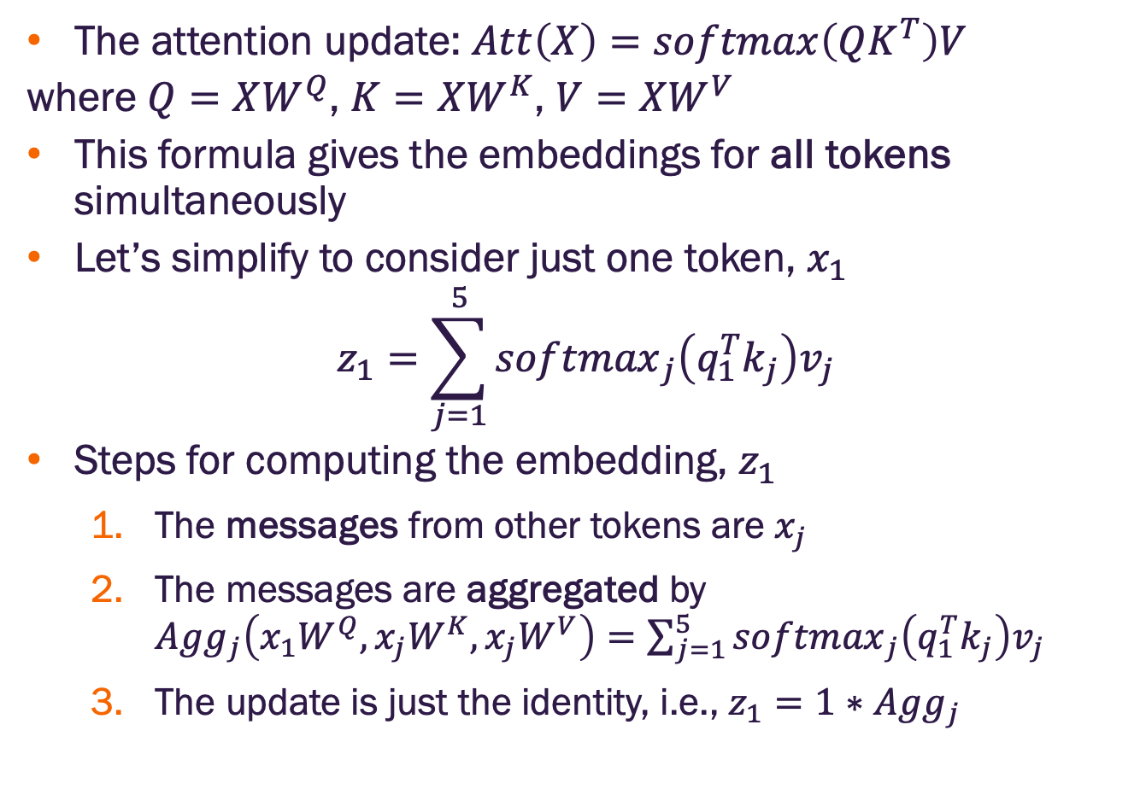
Self-attention can be cast as message passing
The attention update: $Att\left(X\right)=softmax\left(QK^{T}\right)V$
where $Q=XW^{Q}$, $K=XW^{K}$, $V=XW^{V}$
This formula gives the embeddings for all tokens simultaneously
Let’s simplify to consider just one token, $x_{1}$
$$z_{1}=\sum_{j=1}^{5}{{softmax}_{j}\left(q_{1}^{T}k_{j}\right)v_{j}}$$
Steps for computing the embedding, $z_{1}$
The messages from other tokens are $x_{j}$
The messages are aggregated by ${Agg}_{j}\left(x_{1}W^{Q},x_{j}W^{K},x_{j}W^{V}\right)=\sum_{j=1}^{5}{{softmax}_{j}\left(q_{1}^{T}k_{j}\right)v_{j}}$
The update is just the identity, i.e., $z_{1}=1∗$ ${Agg}_{j}$
Inputs stored row-wise
$$X=\left[−x_{i}−\right]$$
Image credit: Jure Leskovec, http://cs224w.stanford.edu

Slide 27
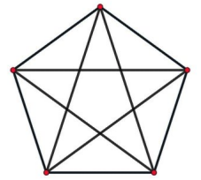
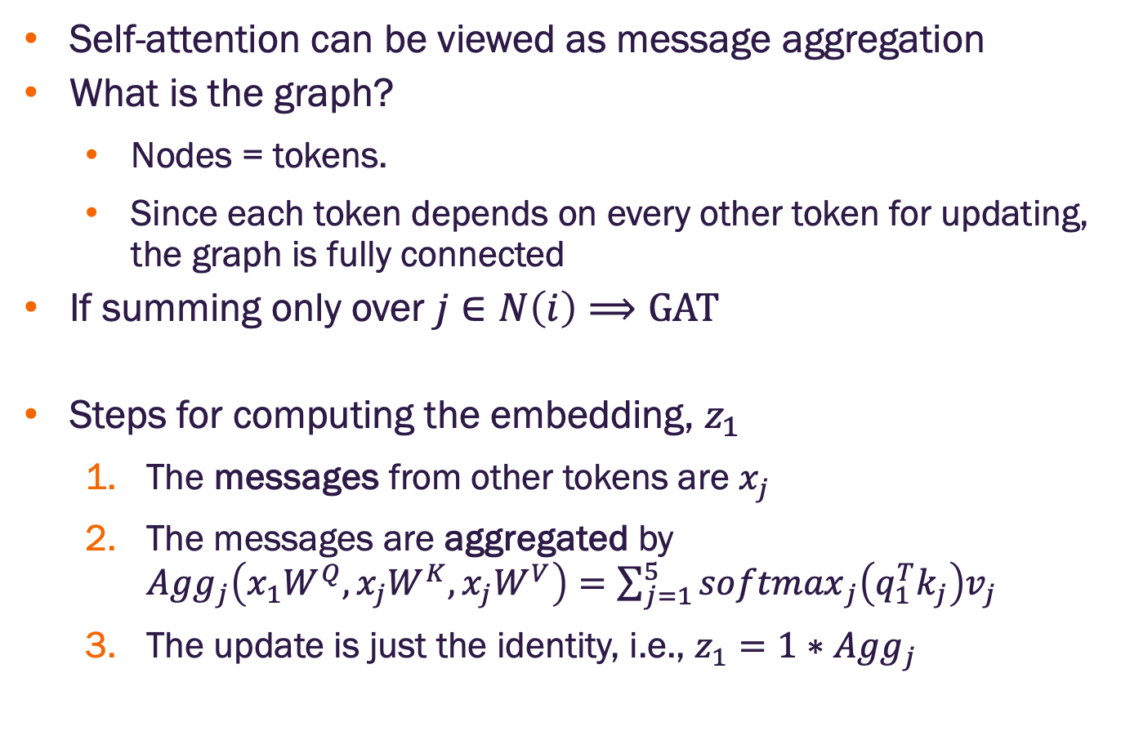
Self-attention can be cast as message passing
Self-attention can be viewed as message aggregation
What is the graph?
Nodes = tokens.
Since each token depends on every other token for updating, the graph is fully connected
If summing only over $j∈N\left(i\right)⟹GAT$
Steps for computing the embedding, $z_{1}$
The messages from other tokens are $x_{j}$
The messages are aggregated by ${Agg}_{j}\left(x_{1}W^{Q},x_{j}W^{K},x_{j}W^{V}\right)=\sum_{j=1}^{5}{{softmax}_{j}\left(q_{1}^{T}k_{j}\right)v_{j}}$
The update is just the identity, i.e., $z_{1}=1∗$ ${Agg}_{j}$
Image credit: Jure Leskovec, http://cs224w.stanford.edu

Slide 28
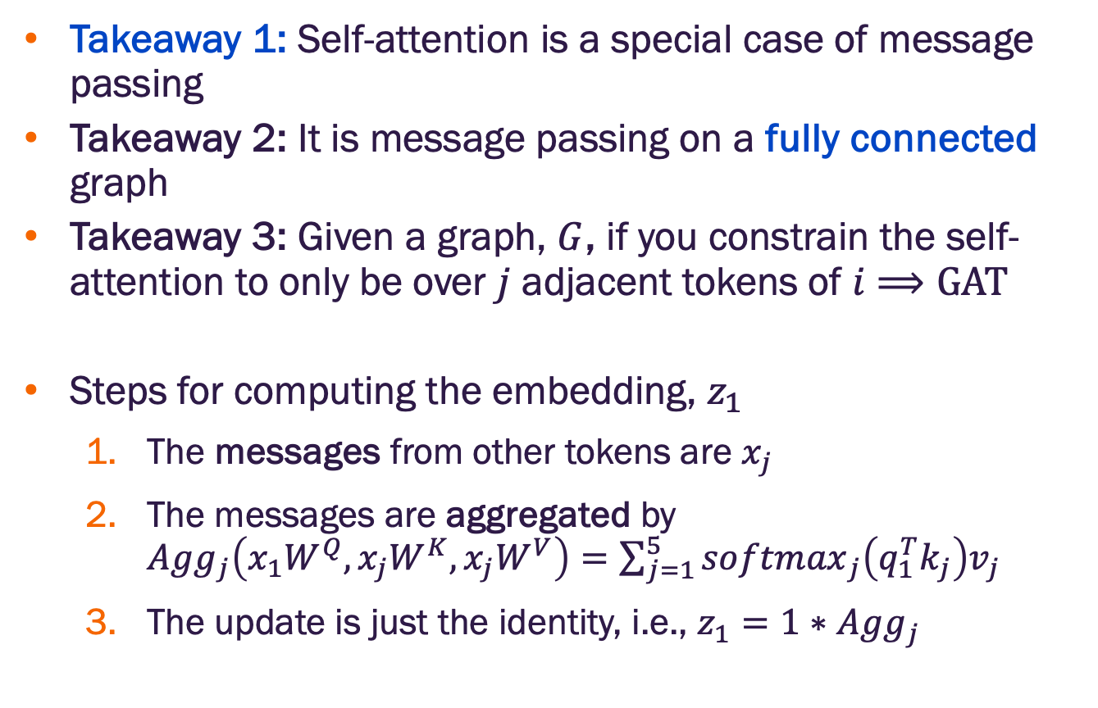
Self-attention can be cast as message passing
Takeaway 1: Self-attention is a special case of message passing
Takeaway 2: It is message passing on a fully connected graph
Takeaway 3: Given a graph, $G$, if you constrain the self-attention to only be over $j$ adjacent tokens of $i$ $⟹GAT$
Steps for computing the embedding, $z_{1}$
The messages from other tokens are $x_{j}$
The messages are aggregated by ${Agg}_{j}\left(x_{1}W^{Q},x_{j}W^{K},x_{j}W^{V}\right)=\sum_{j=1}^{5}{{softmax}_{j}\left(q_{1}^{T}k_{j}\right)v_{j}}$
The update is just the identity, i.e., $z_{1}=1∗$ ${Agg}_{j}$
Image credit: Jure Leskovec, http://cs224w.stanford.edu

Slide 29
Transformers on graphs

Slide 30
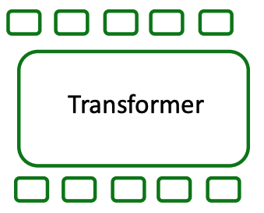
Processing graphs with transformers
We’ve seen how to go from a transformer on tokens to a graph
Image credit: Jure Leskovec, http://cs224w.stanford.edu

Slide 31
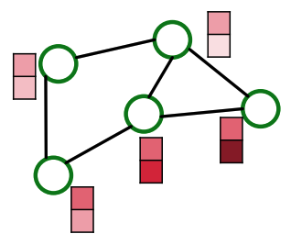
Processing graphs with transformers
How should we input an arbitrary graph into a transformer?
?
Image credit: Jure Leskovec, http://cs224w.stanford.edu

Slide 32
Processing graphs with transformers
How should we input an arbitrary graph into a transformer?
Let’s review the key components of the transformer
Token inputs
Self-attention
Is there anything else?
Image credit: Jure Leskovec, http://cs224w.stanford.edu

Slide 33
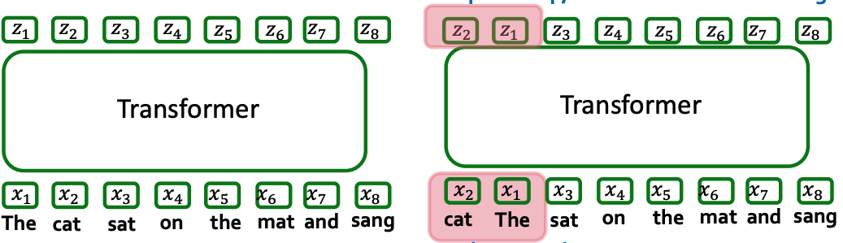
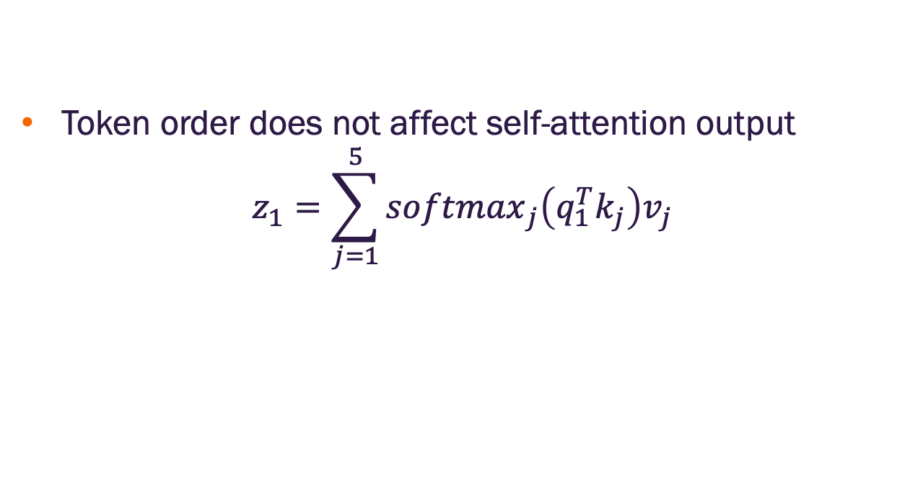
What about token ordering?
Token order does not affect self-attention output
$$z_{1}=\sum_{j=1}^{5}{{softmax}_{j}\left(q_{1}^{T}k_{j}\right)v_{j}}$$
Outputs change position, but not values
Swap token order
Image credit: Jure Leskovec, http://cs224w.stanford.edu

Slide 34
What about token ordering?
Same predictions independent of word order
Equivalent to a bag of words model
Can we fix this?
Identical outputs
Pooling
Pooling
Swap token order
Image credit: Jure Leskovec, http://cs224w.stanford.edu

Slide 35
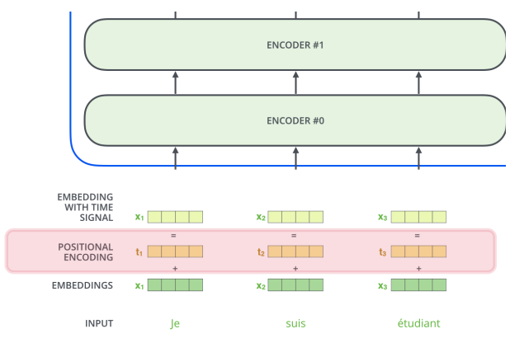
Positional encodings
Add positional features to input tokens to encode word order information
Je = word 1
suis = word 2
etc
For NLP, the positional encoding vectors are learnable parameters
Image credit: Jure Leskovec, http://cs224w.stanford.edu

Slide 36
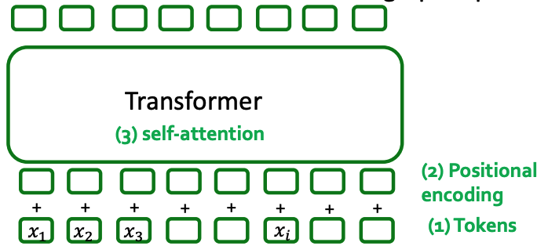
Transformer components
How should we use each of these for graphs?
Image credit: Jure Leskovec, http://cs224w.stanford.edu

Slide 37
Processing graphs with transformers
We need our transformer to take the following inputs:
Node features
Adjacency (edge) information
Edge features
?
Transformer components
Token inputs
Positional encoding
Self-attention
Image credit: Jure Leskovec, http://cs224w.stanford.edu

Slide 38
Processing graphs with transformers
We need our transformer to take the following inputs:
Node features
Adjacency information
Edge features
?
Transformer components
Token inputs
Positional encoding
Self-attention
Different ways to do this mapping
We’ll consider
1 → A
2 → B
3 → C
Image credit: Jure Leskovec, http://cs224w.stanford.edu

Slide 39
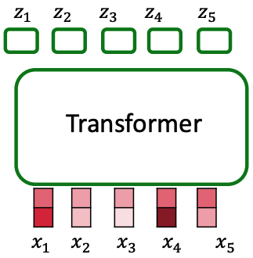
Nodes as tokens
Use node features vectors as input tokens
Matches the idea of “attention as message passing” for a fully connected graph
?
Input tokens = Node features
Image credit: Jure Leskovec, http://cs224w.stanford.edu

Slide 40
Nodes as tokens
Use node features vectors as input tokens
Matches the idea of “attention as message passing” for a fully connected graph
How to include adjacency information for a graph that is not fully connected?
?
Input tokens = Node features
Image credit: Jure Leskovec, http://cs224w.stanford.edu

Slide 41
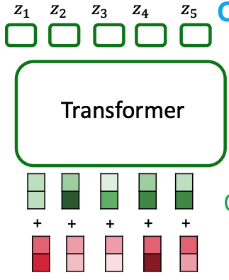
Positional encodings for adjacency?
Encode the adjacency information in the positional encodings
Indicates where a node is in the graph
How do we design the encoding?
?
Positional encoding?
Input tokens = Node features
Image credit: Jure Leskovec, http://cs224w.stanford.edu

Slide 42
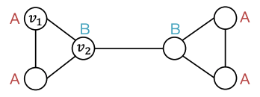
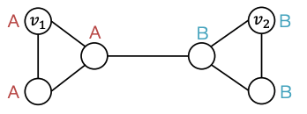
Two types of tasks on graphs
Structure-aware tasks – nodes are labeled by their structural roles in the graph
Position-aware tasks are labeled by their positions in the graph
Image credit: Jure Leskovec, http://cs224w.stanford.edu

Slide 43
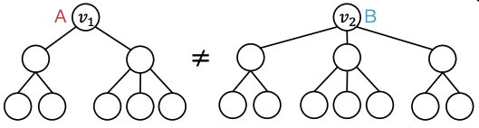
Structure-aware tasks
We’ve seen that GNNs work well for differentiating nodes with different structural roles because they have different computation graphs
Image credit: Jure Leskovec, http://cs224w.stanford.edu

Slide 44
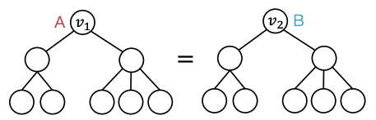
Position-aware tasks
Ignoring node features, GNNs will fail on position-aware tasks if the computation graphs are the same due to structural symmetry
Can we address this?
Image credit: Jure Leskovec, http://cs224w.stanford.edu

Slide 45
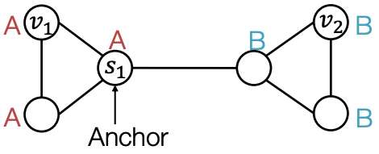

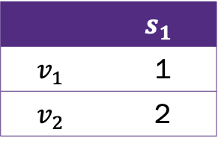
Anchors for position aware graph tasks
Randomly pick a node $s_{1}$ as an anchor
Represent nodes $v_{1}$ and $v_{2}$ by their edge distance to the anchor
Anchor node serves as a coordinate axis
Edge Distances
 | $$s_{1}$$
$$v_{1}$$ | 1
$$v_{2}$$ | 2
Image credit: Jure Leskovec, http://cs224w.stanford.edu

Slide 46
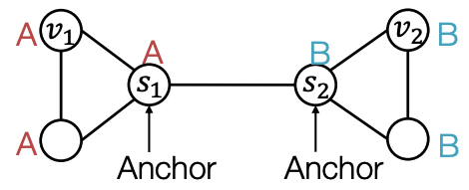
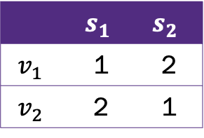
Anchors for position aware graph tasks
Randomly pick more anchor nodes
More anchors can better characterize node position relative to different regions of the graph
Multiple anchors correspond to multiple coordinate axes
Edge Distances
 | $$s_{1}$$ | $$s_{2}$$
$$v_{1}$$ | 1 | 2
$$v_{2}$$ | 2 | 1
Image credit: Jure Leskovec, http://cs224w.stanford.edu

Slide 47
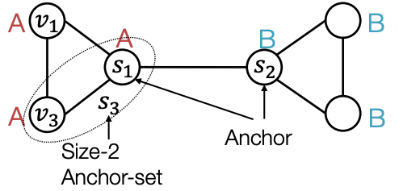
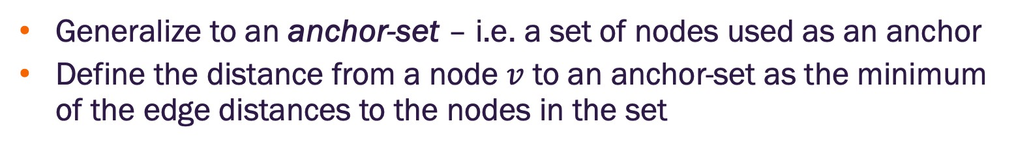


Anchors for position aware graph tasks
Generalize to an anchor-set – i.e. a set of nodes used as an anchor
Define the distance from a node $v$ to an anchor-set as the minimum of the edge distances to the nodes in the set
Edge Distances
 | $$s_{1}$$ | $$s_{2}$$ | $$s_{3}$$
$$v_{1}$$ | 1 | 2 | 1
$$v_{3}$$ | 1 | 2 | 0
Anchor set $s_{1}$, $s_{2}$ cannot differentiate nodes $v_{1}$, $v_{3}$ but anchor $s_{3}$ can
Image credit: Jure Leskovec, http://cs224w.stanford.edu

Slide 48
How is anchor-set information used in GNNs?
Use position encoding as an augmented node feature (works well in practice)
Issue: this position encoding is not permutation invariant
A rigorous solution is detailed in Position-aware GNNs by You et al.

Slide 49
Positional encodings for adjacency?
Encode the adjacency information in the positional encodings
Indicates where a node is in the graph
How do we design the encoding?
?
Positional encoding?
Input tokens = Node features
Image credit: Jure Leskovec, http://cs224w.stanford.edu

Slide 50

Relative distances for transformer positional encoding
Works well in many cases
Especially good for tasks that require counting cycles
Edge Distances
 | $$s_{1}$$ | $$s_{2}$$ | $$s_{3}$$
$$v_{1}$$ | 1 | 2 | 1
$$v_{3}$$ | 1 | 2 | 0
Image credit: Jure Leskovec, http://cs224w.stanford.edu

Slide 51
Relative distances for transformer positional encoding
Works well in many cases
Especially good for tasks that require counting cycles
But not well suited for structure-aware tasks
What else can we do?
Edge Distances
 | $$s_{1}$$ | $$s_{2}$$ | $$s_{3}$$
$$v_{1}$$ | 1 | 2 | 1
$$v_{3}$$ | 1 | 2 | 0
Image credit: Jure Leskovec, http://cs224w.stanford.edu

Slide 52

Graph Laplacian
The graph Laplacian, $L$, of a simple undirected network is an $n×n$ matrix with elements
$$l_{ij}=k_{i}δ_{ij}−a_{ij}=\left\{\begin{matrix}k_{i} if i=j \\ −1 if i≠j and there is an edge from i to j \\ 0 otherwise \end{matrix}\right.$$
where $k_{i}$ is the degree of node $i$ and $δ_{ij}$ is the Kronecker delta ($1$ if $i=j$ and $0$ otherwise
Matrix form $L=D−A$ where
$$D=\left(\begin{matrix}k_{1} & 0 & ⋯ \\ 0 & k_{2} & ⋯ \\ ⋮ & ⋮ & ⋱\end{matrix}\right)$$
For weighted networks, substitute the weighted adjacency matrix and $k_{i}=\sum_{j}{a_{ij}}$
No extensions for networks with self-edges or directed networks

Slide 53



Laplacian Eigenvector positional encodings
Laplacian matrix, $L$, captures graph structure
Its Eigenvectors encode this structure
Multiplicity of zero eigenvalue equals number of connected components
Second smallest eigenvalue is a measure of graph connectivity
Eigenvectors partition the graph into communities via sign structure
Let’s use these as positional encoding for transformers
Refresher
$$Lx=λx$$
$L:n×n$ matrix, where $n$ is the number of nodes
$x:n$ dimensional vector
$λ:$ scalar Eigenvalue

Slide 54




Laplacian Eigenvector positional encodings
Creating positional encodings from Eigenvectors
Compute $k$ Eigenvectors, $e_{k}$
Stack left to right to form a matrix
$i^{th}$ row is positional encoding for node $v_{i}$
$$e_{1}$$ | $$e_{2}$$ | … | $$e_{k}$$
n nodes
row $i$
Positional encoding
Node features
Image credit: Jure Leskovec, http://cs224w.stanford.edu

Slide 55


Eigenvector sign ambiguity
Suppose $x$ is a Laplacian eigenvector such that $Lx=λx$
This implies $L\left(−x\right)=λ\left(−x\right)$
So $−x$ is also a Laplacian eigenvector
The sign choice is arbitrary
Image credit: Jure Leskovec, http://cs224w.stanford.edu

Slide 56

Eigenvector sign ambiguity
What if we picked the other sign?
Then the input positional encoding changes, and the model output changes
For $k$ eigenvectors, there are $2^{k}$ sign choices
Image credit: Jure Leskovec, http://cs224w.stanford.edu

Slide 57

Fixing Laplacian eigenvector sign ambiguity
Build a neural network that is invariant to sign choices (i.e., the outputs won’t change with sign choice)
$$f\left(e_{1},⋯,e_{k}\right)=f\left({±e}_{1},⋯,{±e}_{k}\right)$$
Theorem (single input): $f\left(e_{1}\right)=f\left({−e}_{1}\right)$ (i.e. $f$ is sign invariant) if and only if there is a function $φ$ such that $f\left(e_{1}\right)=φ\left(e_{1}\right)+φ\left(−e_{1}\right)$
Theorem (multiple inputs): if $f\left(e_{1},⋯,e_{k}\right)$ is sign invariant, then there exist functions $ρ$ and $φ$ such that
$$f\left(e_{1},⋯,e_{k}\right)=ρ\left[φ\left(e_{1}\right)+φ\left({−e}_{1}\right),⋯,φ\left(e_{k}\right)+φ\left({−e}_{k}\right)\right]$$

Slide 58

SignNet
As proposed by Lim et al.
$$f\left(e_{1},⋯,e_{k}\right)=ρ\left[φ\left(e_{1}\right)+φ\left({−e}_{1}\right),⋯,φ\left(e_{k}\right)+φ\left({−e}_{k}\right)\right]$$
where $ρ$ and $φ$ are neural networks, and $k$ is the number of eigenvectors
SignNet can express all sign invariant functions
Lim et al, https://arxiv.org/pdf/2202.13013

Slide 59

SignNet in practice
Compute Laplacian eigenvectors
Create Laplacian eigenvector embeddings using SignNet
Concatenate SignNet embeddings with node features
Pass through GNN or Transformer
Backpropagate gradients to train SignNet and GNN or Transformer jointly
Image credit: Lim et al, https://arxiv.org/pdf/2202.13013

Slide 60
Finally, how should we address edge features?
We need our transformer to take the following inputs:
Node features
Adjacency (edge) information
Edge features
?
Transformer components
Token inputs
Positional encoding
Self-attention
Different ways to do this mapping
We’ll consider
1 → A
2 → B
3 → C
Image credit: Jure Leskovec, http://cs224w.stanford.edu

Slide 61

Edge features through modified self-attention
Recall, the attention weights, $\left[a_{ij}\right]=QK^{T}$, applied to token $j$ by token $i$ in transformers where $Q=XW^{Q}$, $K=XW^{K}$
Idea: adjust these to include edge features. Set $a_{ij}=a_{ij}+c_{ij}$ where $c_{ij}$ depends on edge features

Slide 62

Edge features through modified self-attention
Recall, the attention weights, $\left[a_{ij}\right]=QK^{T}$, applied to token $j$ by token $i$ in transformers where $Q=XW^{Q}$, $K=XW^{K}$
Idea: adjust these to include edge features. Set $a_{ij}=a_{ij}+c_{ij}$ where $c_{ij}$ depends on edge features
Implementation
If there is an edge between $i$ and $j$ with features ${\tilde{x}}_{ij}$ define $c_{ij}=w_{1}^{T}{\tilde{x}}_{ij}$ where $w_{1}$ is a learnable parameter. There will be $m$ such parameters, $w_{1},⋯,w_{m}$one for each edge
If there is no edge, find the shortest edge path between $i$ and $j$ with feature set $\left\{{\tilde{x}}_{i,n_{1}},{\tilde{x}}_{n_{1},n_{2}},⋯{\tilde{x}}_{n_{k,j}}\right\}$ and define $c_{ij}=\sum_{k}{w_{k}^{T}{\tilde{x}}_{k}}$

Slide 63
Graph transformer design summary
Tokenization
Usually node features
Other options include subgraphs, node + edge features
Positional encoding – relative distances or Laplacian eigenvectors
Modified attention for edge features
Edge features
Positional encoding
Node features
Image credit: Jure Leskovec, http://cs224w.stanford.edu

Slide 64
A reality check
Implementing graph transformers in the standard Transformer model still presents limitations
Positional encodings help, but exact adjacency information is lost
Efficient implementation requires batching which in turn requires padding with “ghost” nodes (more in the lab)
Several hybrid GNN-Transformer approaches have been developed
TransformerConv (next lab) - https://arxiv.org/abs/2009.03509
GPSConv - https://proceedings.neurips.cc/paper_files/paper/2022/hash/5d4834a159f1547b267a05a4e2b7cf5e-Abstract-Conference.html
HGTConv - https://arxiv.org/abs/2003.01332

Slide 65


